Slide 1
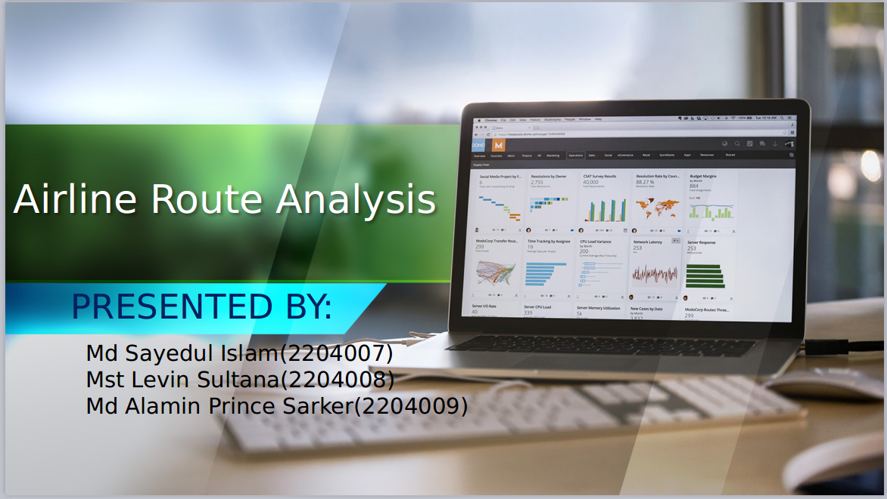



01/12/2024
BUSINESS REPORT
Created by Aldenaire & Partners

Slide 2
PROJECT SUPERVISOR
Mr. Md. Rajibul Islam
Lecturer
Department of computer Science & Engineering
DUET, Gazipur
Dr. Md. Shafiqul Islam
Professor
Department of computer Science & Engineering
DUET, Gazipur

Slide 3


Objective
Analyze airline route data to identify the busiest routes globally.
Focus on international routes.
Insights into passenger traffic trends.
Visualization of data trends using bar charts and other graphical tools.

Slide 4
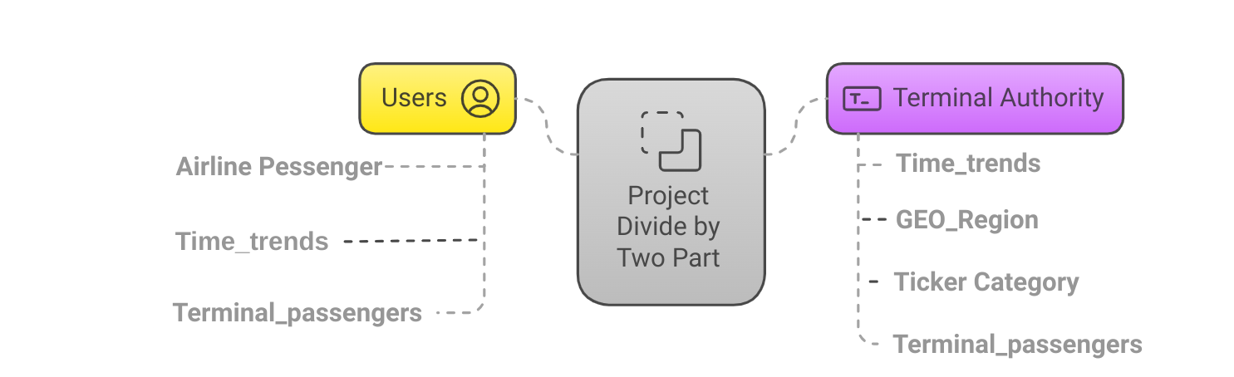

Project Overview

Slide 5

User Benefited From This Project

Slide 6
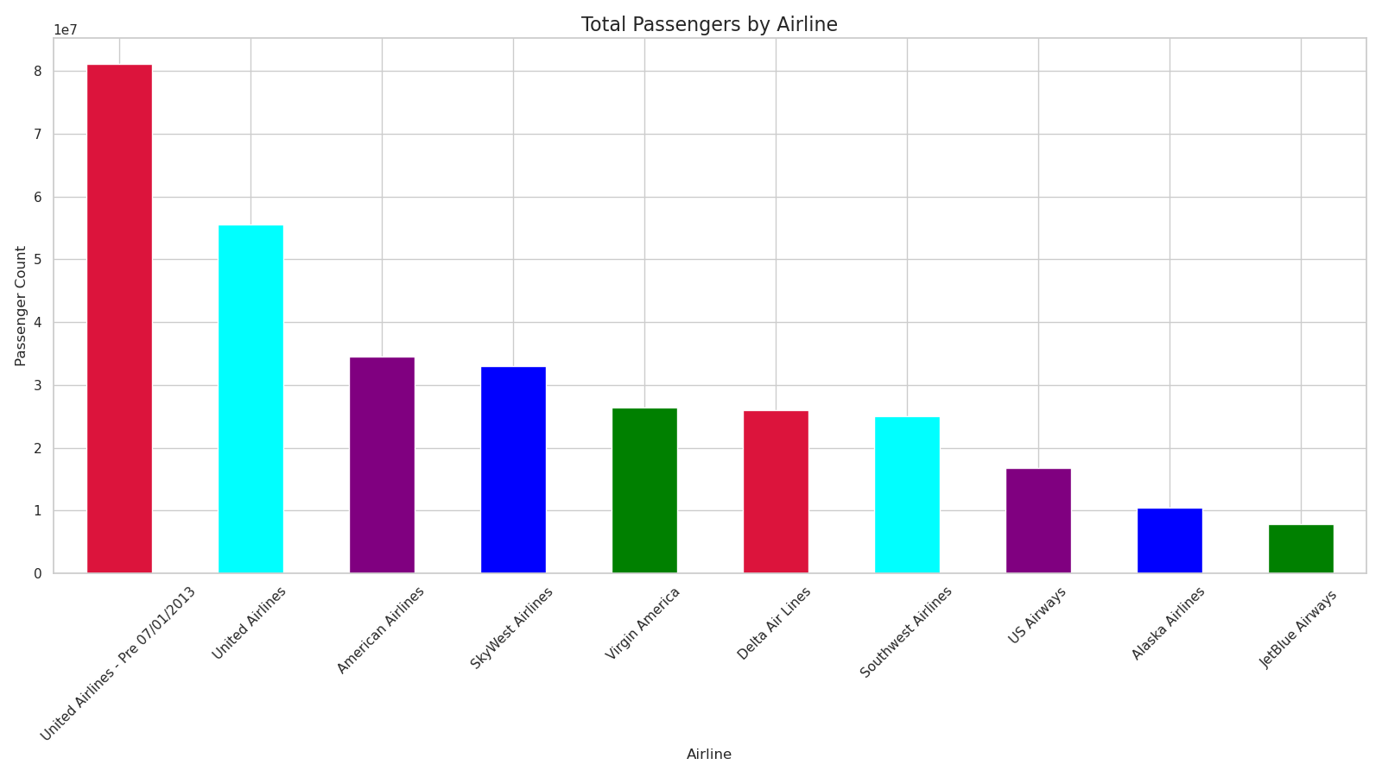

Slide 7
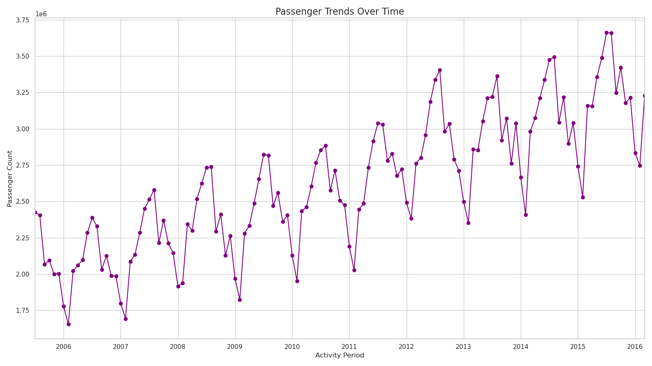

Slide 8
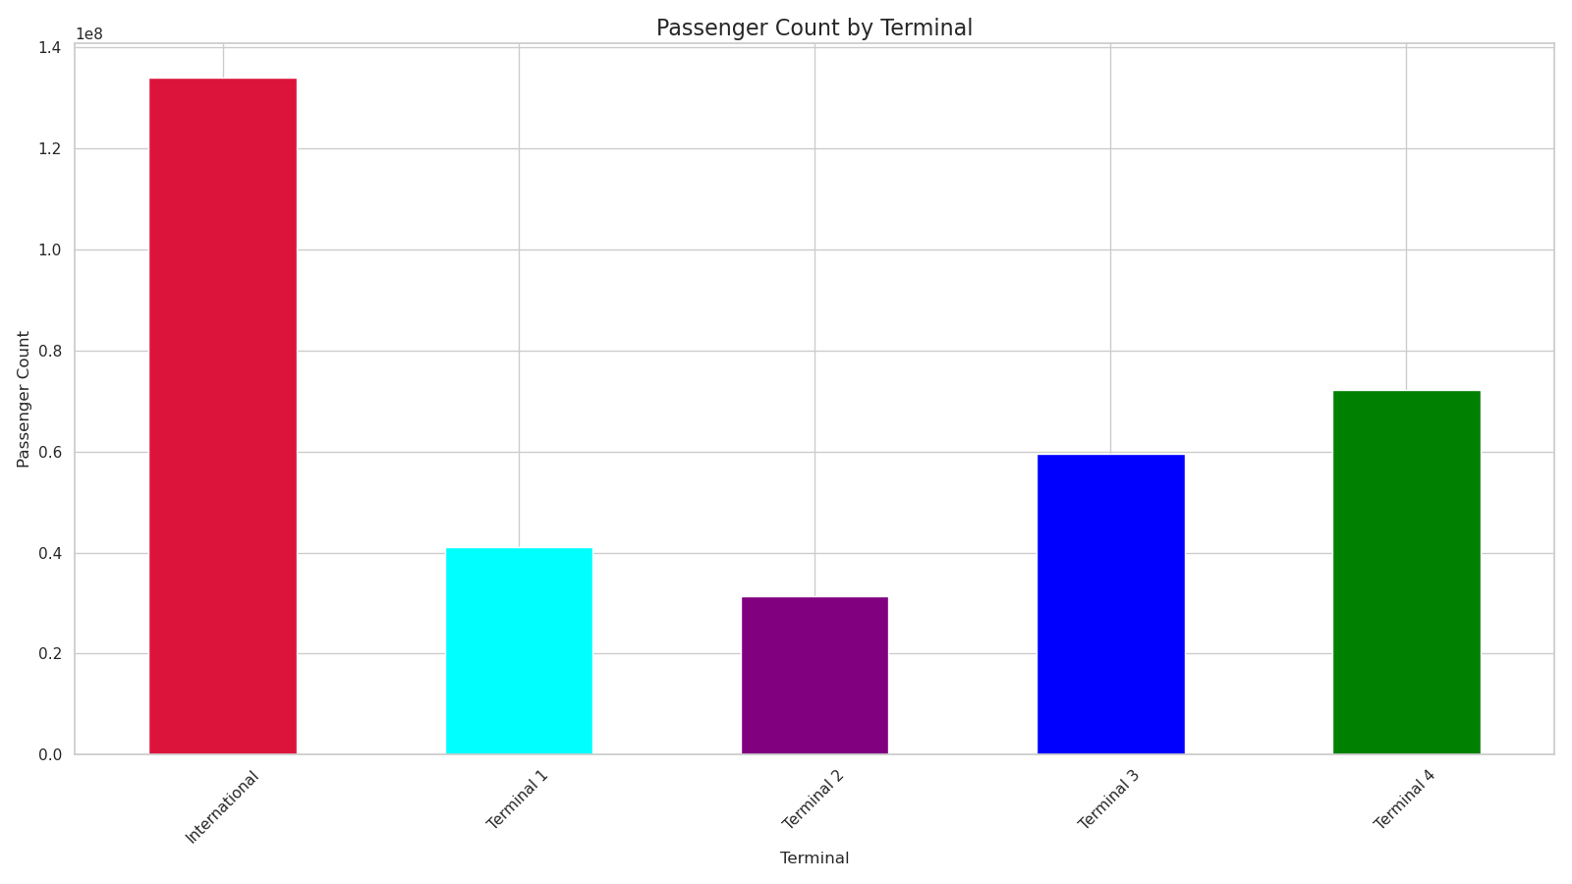
Goals

Slide 9
Airport Authority Benefited From This Project

Slide 10
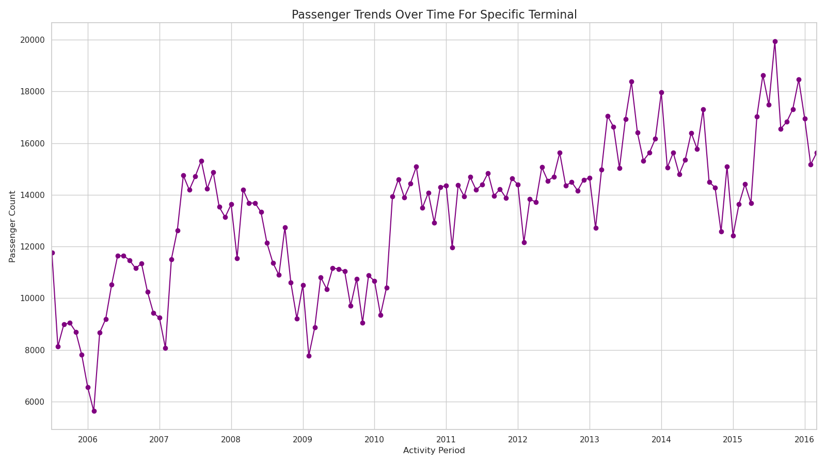

Slide 11
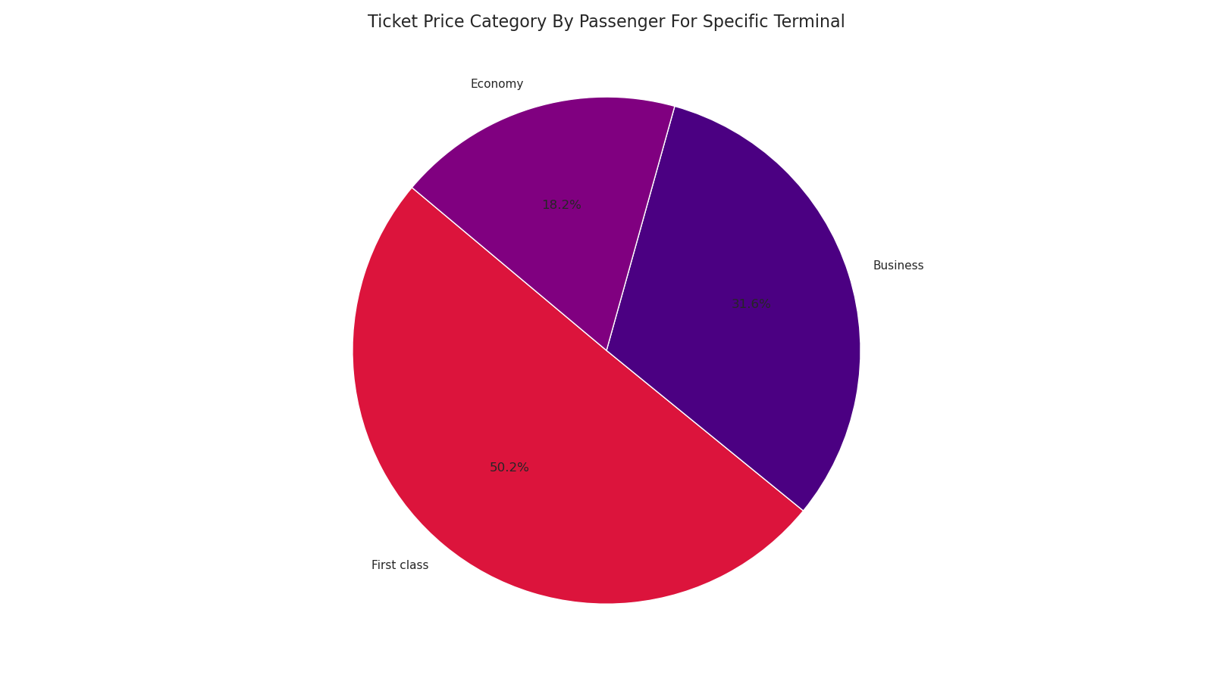

Slide 12
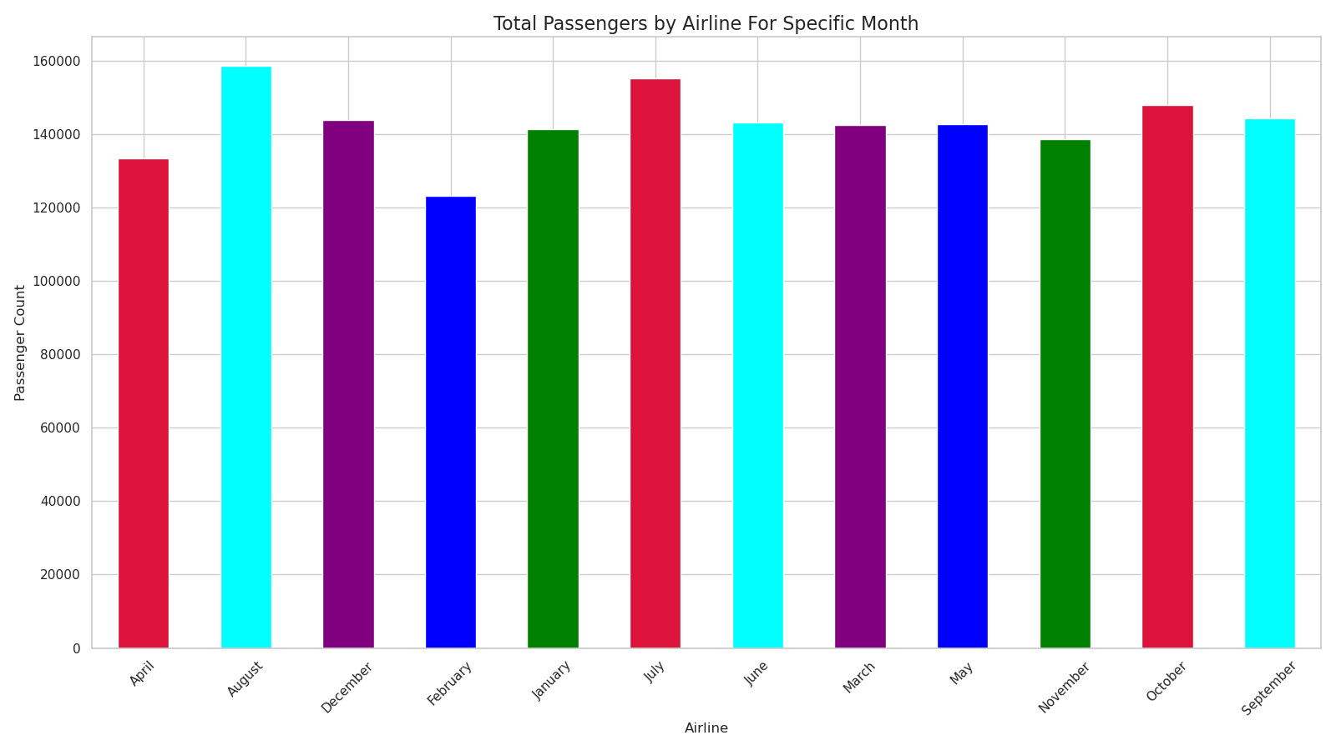

Slide 13
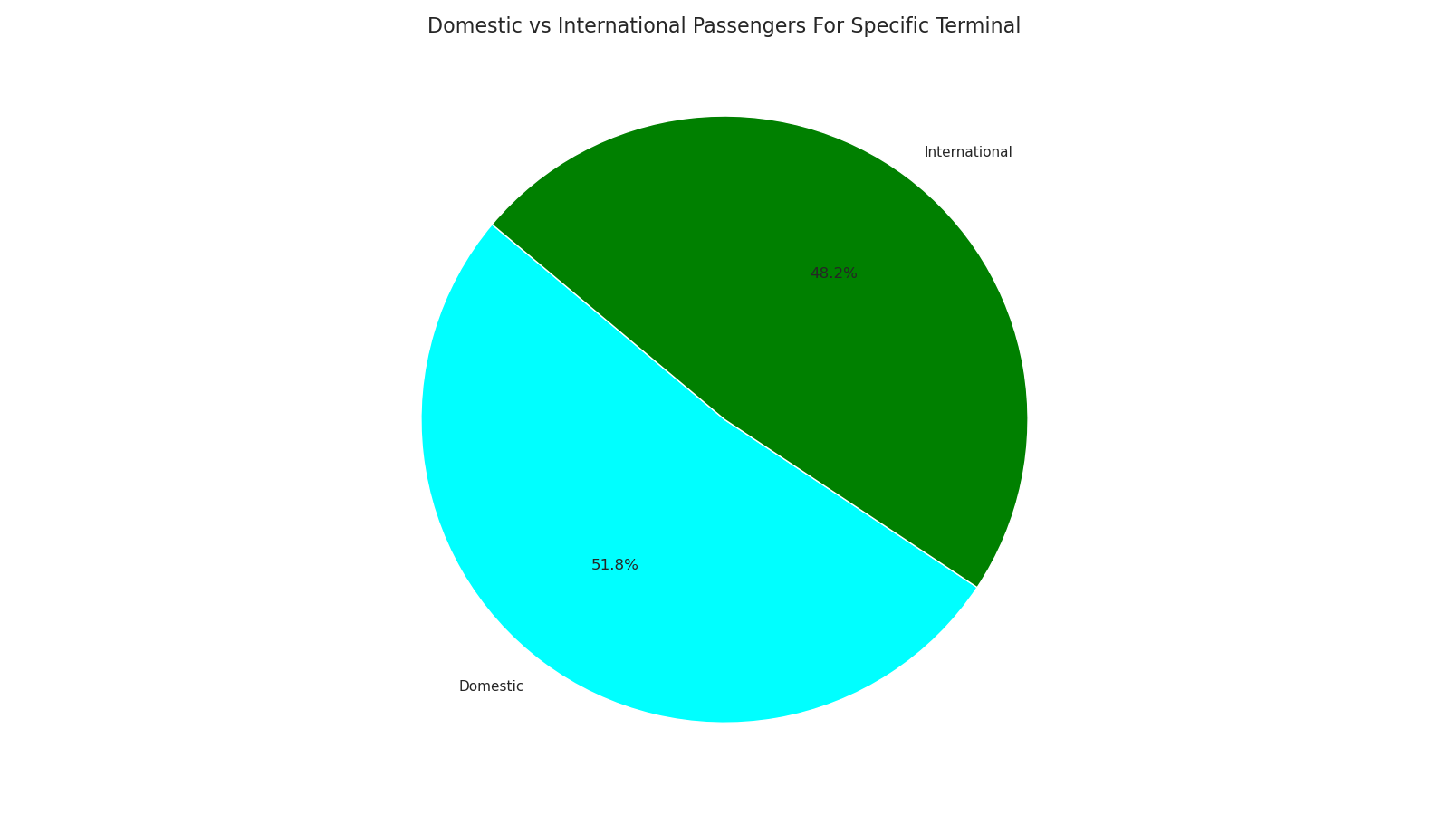

Slide 14

Using Tools and Technologies
Data Analysis: Python, Pandas, NumPy
Data Visualization: Matplotlib, Seaborn, pandas
Dataset Storage and Processing: Jupyter Notebook, CSV files
$ 1,36 billion Total net assets
150+ Projects On Going
350+ Projects
500+ Employee
9.000 Clients

Slide 15
Any question

